Slide 1
www.MINEPORTAL.in
ONLINE TEST SERIES FOR
DGMS COAL/METAL FIRST/SECOND CLASS EXAM
GATE MINING EXAM
OVERMAN EXAM TEST
MINING INSPECTOR EXAMS
COAL INDIA MTs & OTHER PSUs EXAMS
FREE STUDY MATERIAL & VIDEO LECTURES
MINING JOBS NOTIFICATIONS
www.mineportal.in Call/Whatsapp-8804777500 www.fb.com/mineportal.in

Slide 2
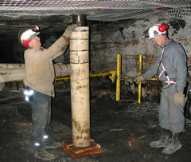
Unit Operations In Underground Mining

Slide 3
Definition
A unit operation is defined as a particular process for a specific step in underground mining. Such as drilling, blasting, loop supporting, loading, hauling

Slide 4
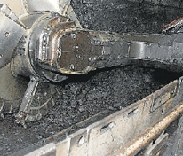
Modification of mine.

Slide 5
Production cycle
By production cycle, we mean the whole process or it can be visualised as
Production cycle = drilling + blasting + roof support + loading + haul.

Slide 6
Types of PCUO
Production cycle unit operations can be divided in two categories
Rock breakage
Material handling

Slide 7
Rock breakage
Rock breakage unit operation of underground mining mainly consists of drilling and blasting operations.
This is the first and formost step of mining without which we can’t proceed to next step of exploitation of resources. So this step qualifies as the most precaution-taking step.

Slide 8
Material handling
Material handling by very name suggests how to cautiously handle materials. It is mainly of three types
Loading – Excavation of minerals
Haulage- horizontal transport
Hoisting – vertical transport

Slide 9
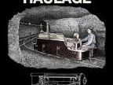
Haulage system

Slide 10
Blasting
Blasting operation in underground mining mainly consists of solid blasting. Now, for blasting a surface we must have some free surface.
Free surface is referred to as that area of a mine that is exposed to air and can be used to enter the mine after blasting

Slide 11
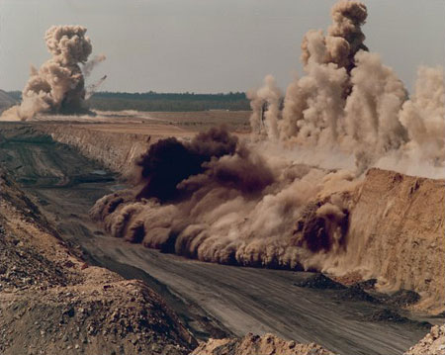
Blasting operation

Slide 12
Powder factor
Powder factor is a very helpful tool in determining the or estimating the quality of an explosive.
Powder factor = tons of rock broken(tonn)
explosive used (kg)

Slide 13
Galleries
A gallery is a long path of specific dimensions (initially fixed) which serves as the way to mine and helps us in easy excavation of resources. It is supported by pillars (even which are of the same mineral).
This is a particular gallery of 4.8m x 3m. This is the maximum permitted dimension of a gallery in mining by DGMS.

Slide 14
Types of galleries
V- cut or wedge
Pyramid or diamond cut
Fan cut
Burn cut

Slide 15
Thank you all for patient and keen listening.
Jaibeer Singh. ☺
10108EN014
Mining engg. Part II

